Slide 1
What is transgenic animal?
A transgenic animal is an animal that has been genetically engineered to contain one or more extra genes in its cell. It now has a new, inheritable property of some type.

Slide 2
Genetically Modified Organisms
Genetically modified organisms are organisms with artificially altered DNA.
Created By:
Adding a foreign gene
Altering the base sequence of an existing gene

Slide 3
Purpose
Efficiency in utilizing Feed
Leaner meat production
Ability to grow to marketable size sooner
Resistance to certain diseases
Transgenic animals as living bioreactors
Molecular pharming or molecular farming

Slide 4
Altering an Existing Gene
Existing genes in the organism are altered to make it produce at higher levels (Growth hormone).

Slide 5
Genetically Modified Animal
Microinjection
Embryonic stem cell transfer
Retroviral Transfer

Slide 6
Microinjection
Eggs are harvested from super-ovulated animals and fertilized in vitro.
Implanted into surrogate mothers.
A small proportion of the animals born are transgenic.

Slide 7
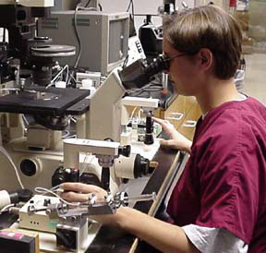
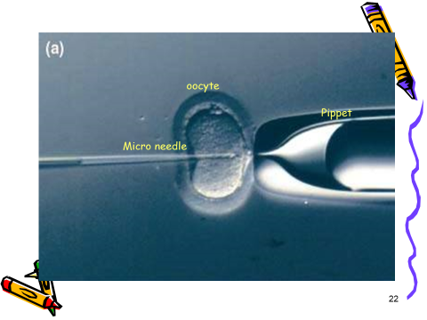
MICROINJECTION PROCESS

Slide 8
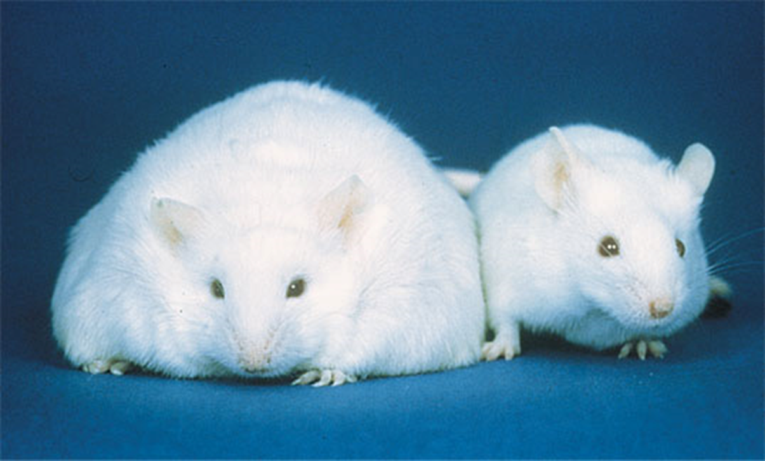

Slide 9
Embryonic stem cell transfer
Target gene sequences to specific sites in the genome
Alternations made to stem cells in culture
Mutated stem cells injected into blastocyst
Blastocyst implanted into foster mother
Transgenic animals are born

Slide 10
Embryonic Stem Cell
Early Fertilization stage
Two Cell Stage
Eight Cell Stage
Four Cell Stage

Slide 11
Embryonic Stem Cell
Blastocyst
Fetus (Pluripotent)
Adult

Slide 16
Transgenic Mice
TM has been used to produce
Human alpha1 antitrypsin
t-PA
HPC
Human fibrinogen

Slide 18
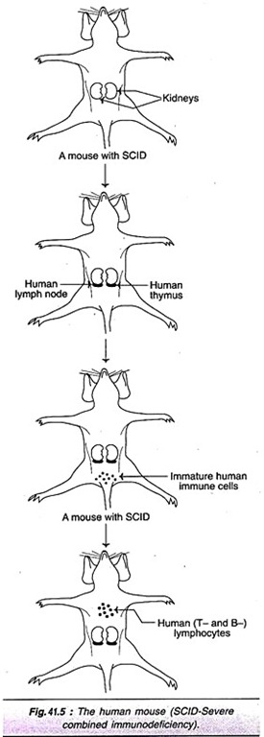
The Human Mouse:
The transgenic mice with human immune system were produced, and they are commonly referred to as human mice . For this purpose, mice with severe combined immuno­deficiency (SCID-a condition characterized by total lack of immune system cells) were chosen.
Human thymus tissue from an aborted fetus was transplanted under the capsule membrane of the kidney of the mouse.
Human lymph node was placed under the opposite kidney. After about a week, immature immune cells (T-lymphocytes) from a human fetus were injected into the mouse tail vein.

Slide 19
These lymphocytes enter the thymus tissue under the kidney and mature to T-lymphocytes. The so produced T-lymphocytes enter the circulation and in the lymph node (present under the second kidney), they multiply to form a full-pledged functional immune system.
The human mouse, being a close animal model for human immune system is a boon for immunologists, particularly working on AIDS. This is because the various immunological aspects of AIDS including the possible development of an AIDS vaccine can be explored by using human mouse

Slide 20
2. The Alzheimer’s Mouse:
Alzheimer’s disease affects about 1% of the population between 60-65 years old, and about 30% of the population over 80 years old.
This disease is characterized by progressive loss of memory and personality changes (decline in thinking, judgment etc.).
The postmortem analysis of brains of Alzheimer’s patients revealed plaques of dead nerve cells entangled in a protein called amyloid.
Transgenic mice were developed by introducing amyloid precursor gene into fertilized egg cells of mice. The synthesis of human amyloid protein and its accumulation as typical plaques in the mice brain were observed.
The Alzheimer’s mouse is very useful in understanding the pathological basis of the disease. Certain mutations in APP gene and the involvement of some other genes are believed to be responsible for Alzheimer’s disease.

Slide 21
3. The Oncomouse:
The animal model for cancer is the oncomouse (onco refers to cancer).
First developed for breast cancer, the oncomouse is useful for understanding of cancer and evolving modalities for cancer therapy.
The oncogene c-myc in association with mouse mammary tumor (MMT) virus was found to be responsible for breast cancer in animals.
Transgenic mice were produced by introducing c-myc gene and sections MMT virus into fertilized mouse egg cells.
Breast cancer developed in adult female mice and the trait was passed on to the offspring. Oncomouse (the mouse that is genetically altered and is susceptible for cancer) was patented by U.S. Patent office in 1988. In fact, it was the very first animal to be patented.

Slide 22
The Knockout Mouse:
The basic principles underlying gene knockout have been described .
Several knockout mice have been developed.
It is not an exaggeration that the knockout mice have become as common as a test tube in the laboratory for a biotechnologist.
It must be noted that not all the knockout mice are immediately useful for human health and welfare. A selected few of the knockout mice are described.
Knockout mouse for allergy:
The receptor sites on certain body cells for IgE antibodies are believed to be responsible for triggering allergy reactions.
Knockout mice were developed for allergy by removing the gene encoding for receptor protein.
The result is that antibodies cannot bind to cells due to lack of receptors and the mice are unaffected by allergic reactions. It is expected that some breakthrough may occur in the near future to benefit the millions of sufferers of allergic reactions, spread throughout the world.

Slide 23
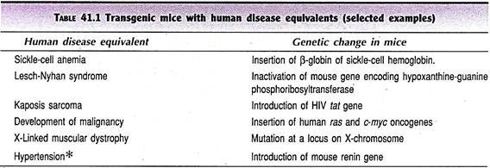
Transgenic Mice for Human Diseases:
Transgenic mice are important for the development of therapeutic drugs and possible gene therapies, besides the understanding of the human disease. Many transgenic mice with human disease equivalents have been developed and a selected few of them are given in

Slide 24
Transgenic PIG
Frequency of transgenic pig production is very low (0.6%).Transgenic pig that carry GH gene of bovine or human, sheep globin have been produced
Marked reduction in some transgenic pigs suggesting the possibility of producing leaner meat with lower fat content.
9.5 bn dollar pig industry
Use in xeno-transplantation

Slide 28
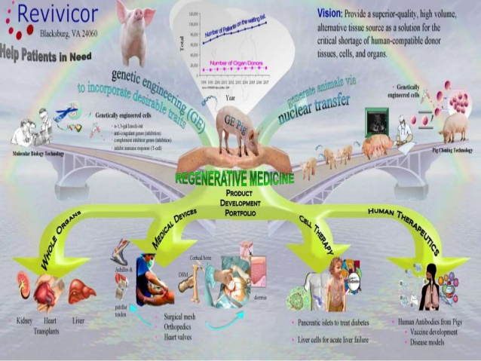

Slide 32
