Slide 1
Horizontal Distribution of Air Pressure and pressure belt
The horizontal distribution of air pressure on the globe is studied on the basis of Isobars. If we look at the globe then it appears that there is certain definite system of high and low pressure.
If, for generalization, the globe is considered to be homogeneous (either of land or water), then there should be regular and systematic zonal distribution of high and low pressure but the regularity of pressure belts is distributed due to unequal distribution of land and water on the globe.
The pressure belts are discontinued in the northern hemisphere and several centers of pressure belt are developed but the pressure belts are found more or less in regular pattern in the southern hemisphere.

Slide 2
continued
There is no definite trend of distribution of pressure from equator towards the poles. If the air pressure would have been the function of air temperature alone there should have been regular increase of pressure pole ward because temperature regularly decrease from the equator towards the poles but this is not the case. Because tropic of Cancer and tropic of Capricorn can not explained on the basis of temperature.
It is obvious that pressure belts are not only induced by thermal factor but they are also induced by dynamic factors.
In all there are seven pressure belts on the globe.

Slide 3
Types of pressure belts on globe
Dynamically induced
Subtropical high pressure belt (North & South)
Subtropical low pressure belt (North & South)
Thermally induced
Equatorial low pressure belt.
Polar high pressure belt (North & South)

Slide 4
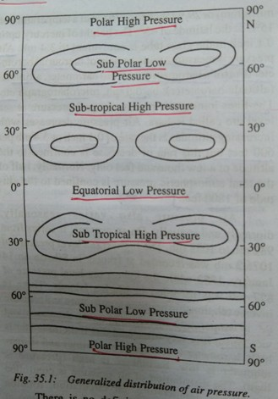

Slide 5
Equatorial low pressure belt
The equatorial low pressure belt is located on either side of the geographical equator in a zone extending between 5°N and 5°S latitudes but this zone is not stationary because there is seasonal shift of this belt with the north ward (Summer solstice) and southward (winter solstice) migration of the sun.
The equatorial low pressure belt is thermally induced because the ground surface is intensely heated during the day due to almost vertical sun rays and thus the lowermost layers of air coming in contact with the heated ground surface also get warmed.
Thus warmed air expands, becomes light and consequently rise upward causing low pressure.
The equatorial low pressure belt represent the zone of convergence of north-east and south-east trade winds.
Because of frequent calm conditions this belt is called a belt of calm or Doldrums.

Slide 6
Sub-tropical high pressure belt
Sub-tropical high pressure belt extends between the latitudes of 25°-35° in both the hemispheres. It is important to note that this high pressure belt is not thermally induced because this zone, beside two to three winter months, receives fairly high temperature throughout the year.
Thus, this belt owns its origin due to the rotation of the earth and sinking and settling down of winds.
It is thus, apparent that the sub-tropical high pressure belt is dynamically induced.

Slide 7
