Slide 1
Mountain
A mountain is a large land form that rise above the surrounding land in a limited area, usually in the form of a peak. A mountain is generally steeper than a hill. Mountains are formed through tectonic forces or volcanism.
Or
A natural elevation of the earth’s surface, and attaining an altitude greater than that of a hill, usually greater than 2000 feet(610 meters above MSL).

Slide 2
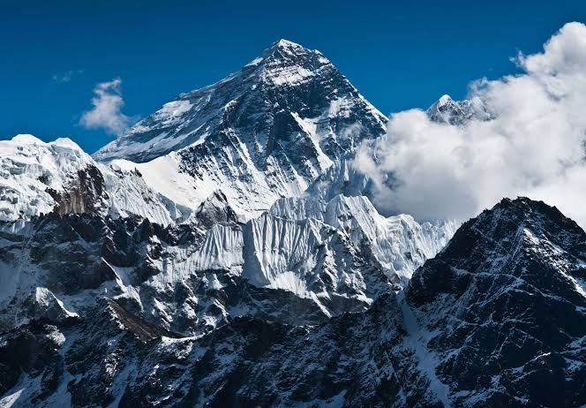

Slide 3
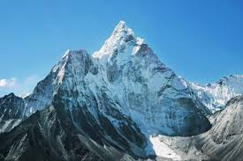

Slide 4
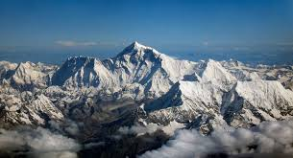

Slide 5
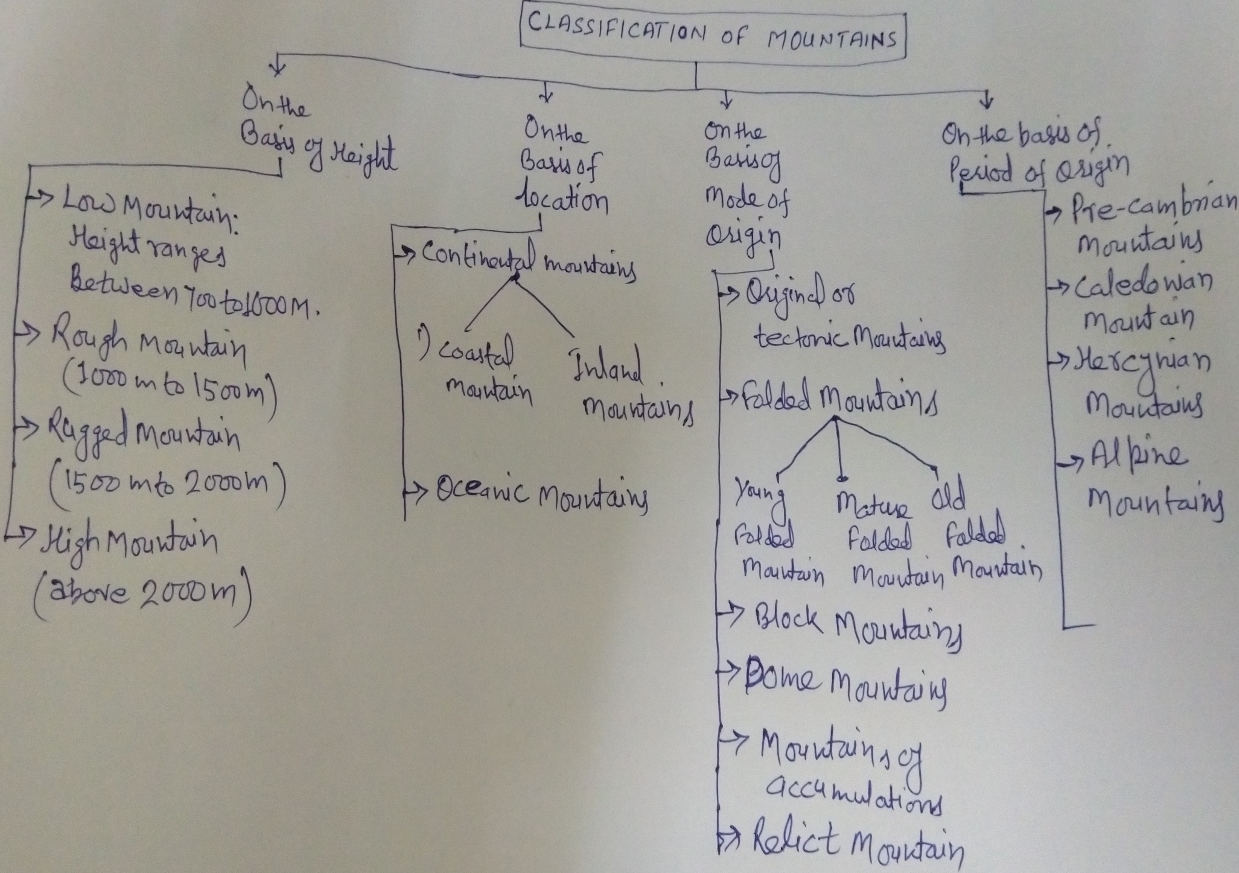

Slide 6
Mountain building theories
GEOSYNCLINES
Meaning and concept:
The geological history of the continents and ocean basins denotes the fact that tin the beginning our globe was characterized by two important features like(1). Rigid masses and (2). Geosynclines. Rigid masses representing the present continents and geosynclines representing the present water body characterized by extensive sedimentation.

Slide 7
Definition of Geosynclines
‘Geosynclines are long but narrow and shallow water depressions characterized by sedimentation and subsidence’.
According to J.A,Steers (1932), ‘the geosynclines have been long and relatively narrow depression which seem to have subsided during the accumulation of sediments in them’.
GENERAL CHARACTERISTICS OF GEOSYNCLINE
1). Geosynclines are long, narrow and shallow depressions of water.
2). These are characterized by gradual sedimentation and subsidence.
3). The nature and patterns of geosynclines have not remained the same throughout geological history, it is due to earth movements and geological process.
4).Geosynclines are mobile zones of water.
5). Geosynclines are generally bordered by two rigid masses which are called forelands and hinterlands.

Slide 8
Evolution of the concept
The concept of geosynclines was given by James Hall and Dana but the concept was elaborated and further developed by Haug.
J.A.Steers (1932), has remarked, while the theory of geosynclines is due to ‘Haug, the concept of idea belong to ‘Hall and Dana’.
CONCEPT OF HALL AND DANA:
Dana studied the folded mountains and postulated that the sediments of the rocks of folded mountains were of marine origin.
These rocks were deposited in long, narrow and shallow seas. Dana named such water bodies as geosynclines.
He defined, for the first time, geosynclines as long, narrow and shallow and sinking beds of seas.

Slide 9
Diagrammatic view of geosynclines

Slide 10
Hall elaborated the concept of geosynclines as advanced by Dana.
He presented ample evidences to show relationship between geosynclines and folded mountains.
He argued that the rocks of folded mountains were deposited in shallow seas.
According to Hall the beds of geosynclines are subjected to subsidence due to continuous sedimentation.
Geosynclines are much longer than their widths.

Slide 11
Concept of E. Haug
The concept of geosynclines developed by ‘Haug’.
He defined geosynclines as long and deep water bodies. According to Haug ‘geosynclines are relatively deep water areas and they are much longer than they are wide.
He drew the palaeogeographical maps of the world and depicted long and narrow oceanic tracts to demonstrate the facts that these water tracts were subsequently folded into mountain ranges.
He further postulated that the positions of the present-day mountains were previously occupied by oceanic tracts like geosynclines.
He further argued that geosynclines existed as mobile zones of water between rigid masses.

Slide 12
He identified 5 major rigid masses during Mesozoic era e.g. (1) North Atlantic mass, (2) Sino-Siberian Mass, (3) Africa-Brazil Mass, (4) Australia-India-Madagascar mass and (5) Pacific mass.
He located 4 geosynclines between these ancient rigid masses e.g. (1) Rockies geosynclines, (2) Ural geosynclines, (3) Tethys geosynclines (4) Circum pacific geosynclines.

Slide 13
Palaeogeographical Maps of Geosynclines

Slide 14
According to Haug there are systematic sedimentation in the geosynclines.
The marginal areas of the geosynclines have shallow water wherein larger sediments are deposited whereas finer sediments are deposited in central parts of the geosynclines.
The sediments are squeezed and folded into mountain ranges due to compressive forces coming from the margins of geosynclines.

Slide 15
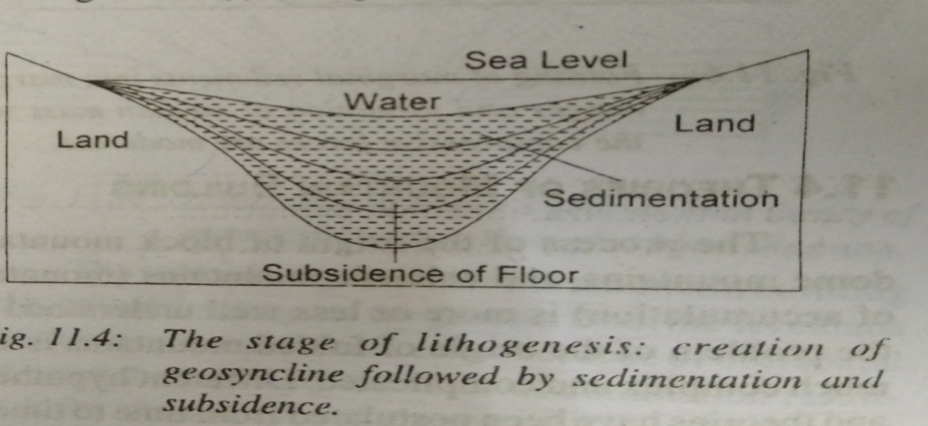
Stages of Geosynclines
The geosynclinal history is divided into three stages :
1). Lithogenesis (the stage of creation of geosynclines, sedimentation and subsidence of the beds of geosynclines.

Slide 16
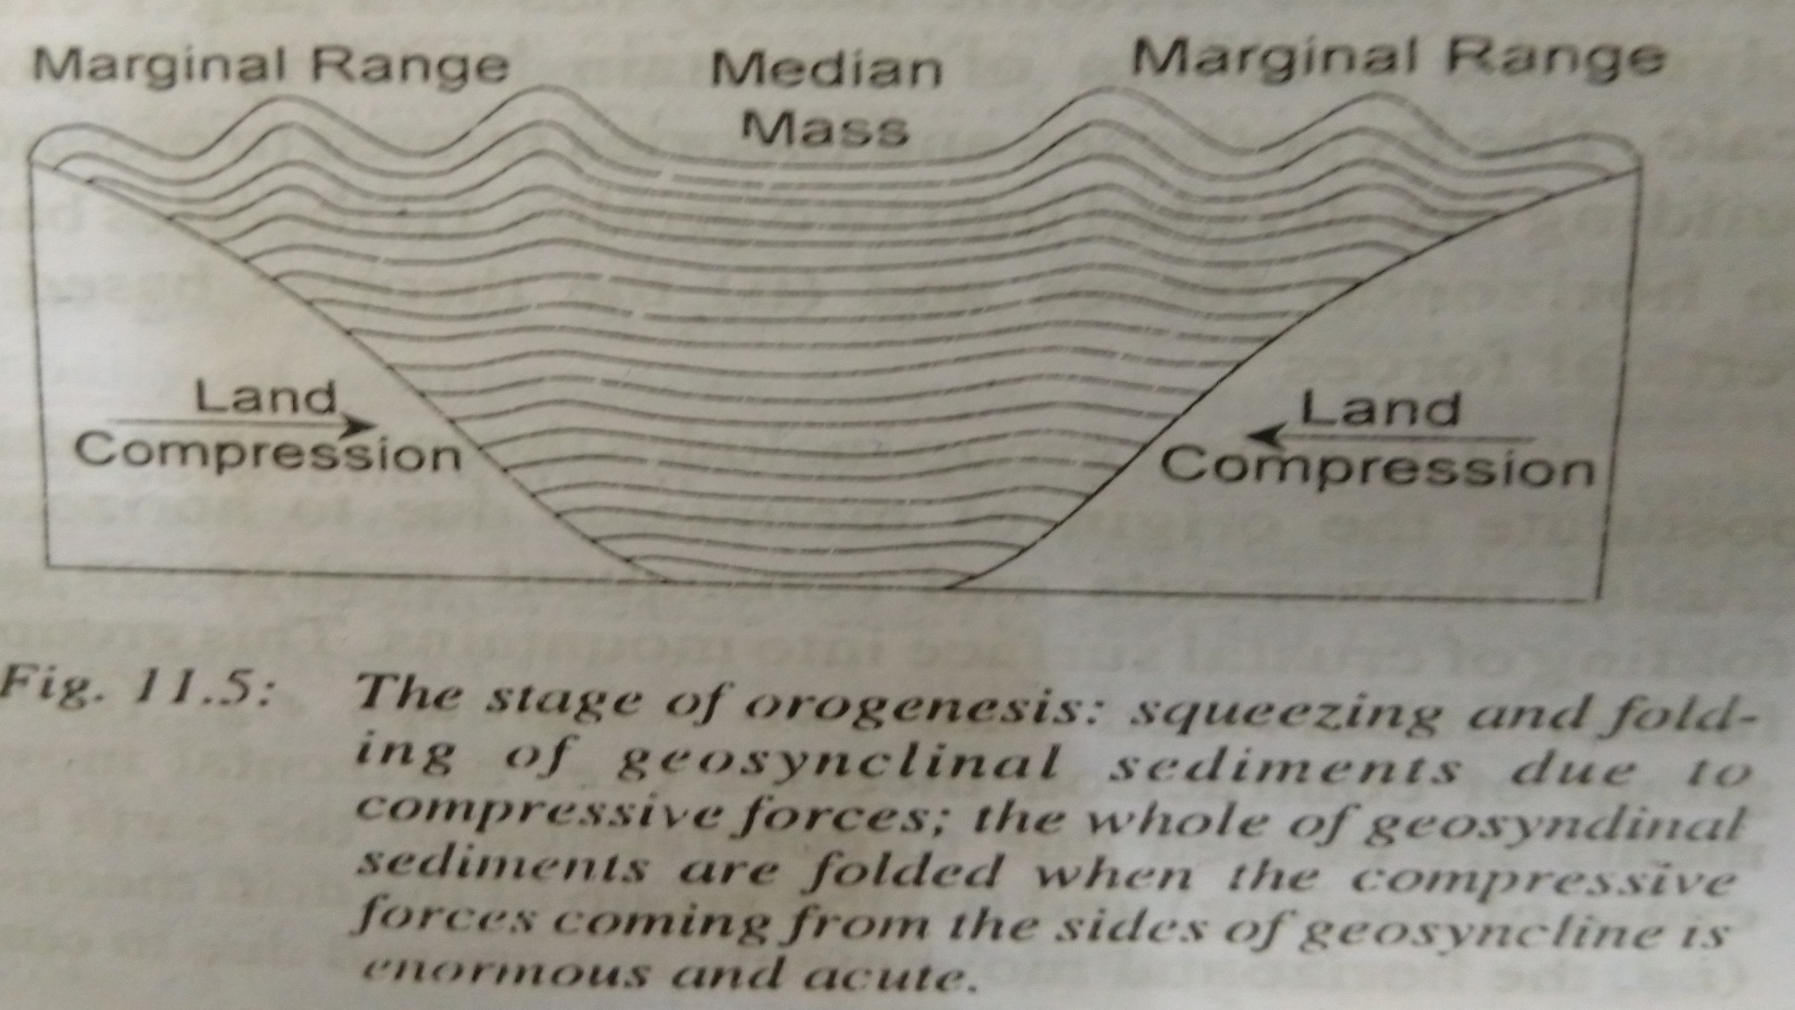
2). Orogenesis (the stages of squeezing and folding of geosynclinal sediments into mountain ranges).

Slide 17
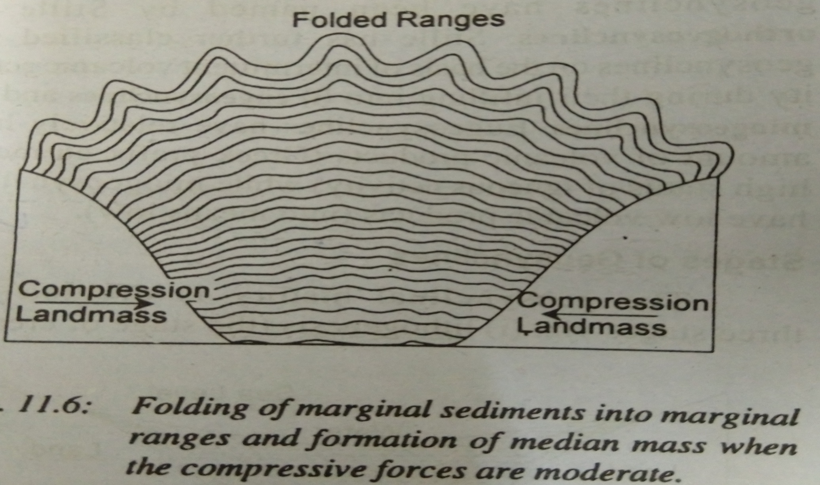
3).Gliptogenesis (the stage of gradual rise of mountains)

Slide 18
Geosynclinal Orogen theory of Kober
Objective of Geosynclinal Orogen theory:
Famous German geologist Kober has presented a detailed and systematic description of the surface features of the earth in his book ‘Der Bau Der Erde’.
His main objective was to establish relationship between ancient rigid masses or tablelands and more mobile zones or geosynclines, which he called Orogen.

Slide 19
Orogenetic Force
Kober’s geosynclinal theory is based on the forces of contraction produced by the cooling of the earth.
In other words, the force of contraction generated due to cooling of the earth causes horizontal movements of the rigid masses or forelands which squeeze, buckle and fold the sediments in to mountain ranges.

Slide 20
Base of the theory
According to Kober there were mobile zones of water in the places of present-day mountains. He called mobile zones of water as geosynclines or orogen (the place of mountain building).
These mobile zones of geosynclines were surrounded by rigid masses which were termed by Kober as Kratogen.

Slide 21
Kober has identified 6 major periods of mountain building.
1) Pre-Cambrian period
2) Palaeozoic era
3) Caledonian period
4) Silurian period
5) Carboniferous period
6) Tertiary epoch

Slide 22
Mechanism of the theory
According to Kober the whole process of mountain building passes through three closely linked stages of lithogenesis, orogenesis and gliptogenesis.
The geosynclines or orogen are long and wide mobile zones of water which are bordered by rigid masses, which have been named by Kober as forelands or Kratogen.
These upstanding land masses or forelands are subjected to continuous erosion by fluvial process and eroded materials are deposited in the geosynclines . This process of sediment deposition is called sedimentation.

Slide 23
Stages of Geosynclines
The geosynclinal history is divided into three stages :
1). Lithogenesis (the stage of creation of geosynclines, sedimentation and subsidence of the beds of geosynclines.

Slide 24
Orogenesis
(the stages of squeezing and folding of geosynclinal sediments into mountain ranges).

Slide 25
Gliptogenesis
3).Gliptogenesis (the stage of gradual rise of mountains.

Slide 26
According to Kober folding of entire sediments of the geosynclines or part thereof depends upon the intensity of compressive forces.
If the compressive forces are normal and of the moderate intensity, only the marginal sediments of the geosynclines are folded to form two marginal randketten (marginal ranges) and middle portion of the geosynclines remain unaffected by folding activity.
This unfolded middle portion is called Zwischengebirge (median mass).
Notes:
kober

Slide 28
Alternatively, if the compressive force are acute, the whole of geosynclines sediments are composed, squeezed, and ultimately folded and both the forelands are closed.

Slide 29
