Slide 1
FLOW CYTOMETRY

Slide 2
FLOW CYTOMETRY
Definition:
Measuring properties of cell as they flow in a fluid suspension across an illuminated light path.

Slide 3
Basic mechanism
Biological sample
Label it with a fluorescent marker
Cells move in a linear stream through a focused light source (laser beam)
Fluorescent molecule gets activated and emits light that is filtered and detected by sensitive light detectors (usually a photomultiplier tube)
Conversion of analog fluorescent signals to digital signals

Slide 4
Flow Cytometry
This method allows the quantitative and qualitative analysis of several properties of cell populations from virtually any type of fresh unfixed tissue or body fluid.
The properties measured include a particle’s related size, relative granularity or internal complexity, and relative fluorescence intensity
Most commonly analyzed materials are:
blood,
bone marrow aspirate and
lymph node suspensions.

Slide 5
Principle of Flow Cytometry
Flow cytometer is composed of three main
components:
  The Flow system (fluidics)
Cells in suspension are brought in single file past
  The Optical system (light sensing)
a focused laser which scatter light and emit
fluorescence that is filtered and collected
  The Electronic system (signal processing) emitted light is converted to digitized values that are stored in a file for analysis

Slide 6
The Flow System
One of the fundamentals of flow cytometry is the ability to measure the properties of individual particles, which is managed by the fluidics system.
When a sample is injected into a flow cytometer, it is
ordered into a stream of single particles.
The fluidic system consists of a FLOW CELL (Quartz Chamber):
  Central channel/ core - through which the sample is
injected.
  Outer sheath - contains faster flowing fluid k/a Sheath fluid (0.9% Saline / PBS) , enclosing the central core.

Slide 7
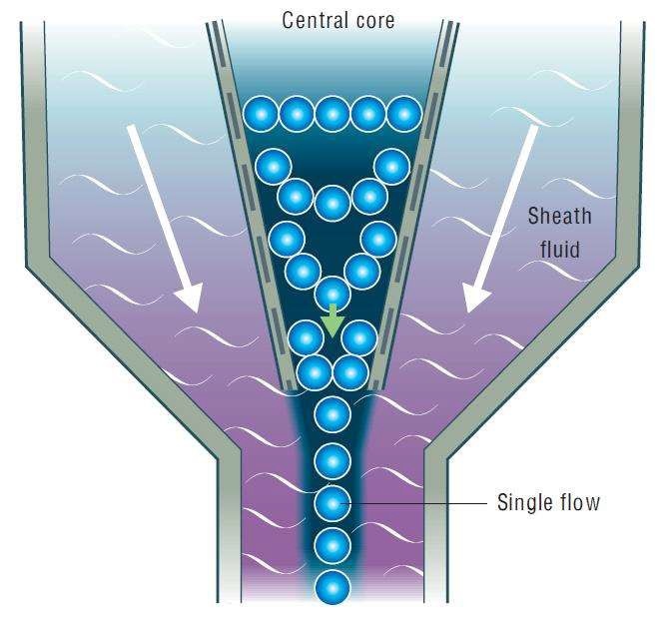
Hydrodynamic Focusing
Once the sample is injected into a stream of sheath fluid within the flow chamber, they are forced into the center of the stream forming a single file by the PRINCIPLE OF HYDRODYNAMIC FOCUSING.
'Only one cell or particle can pass through the laser beam at a given moment.'

Slide 8
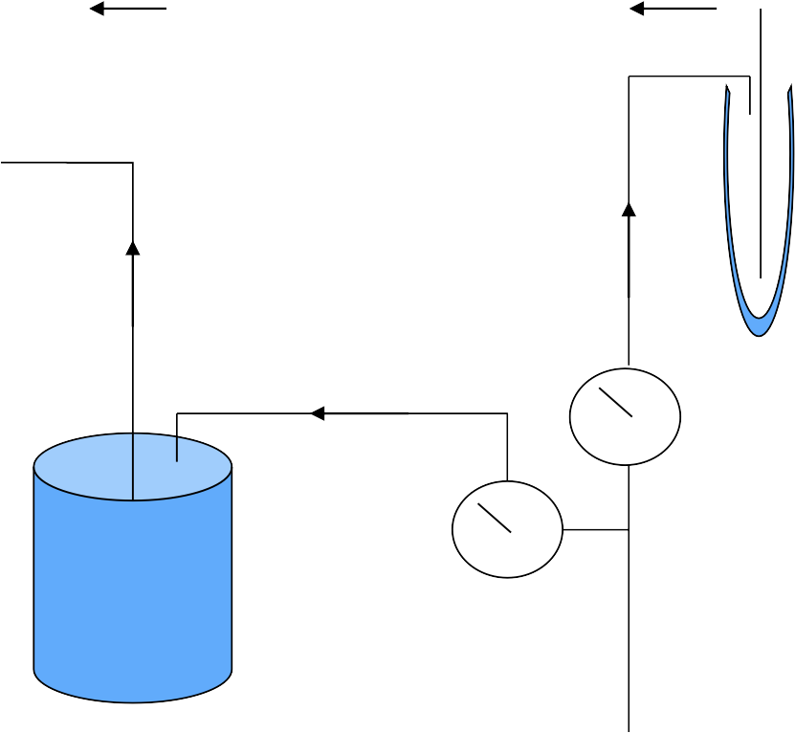

The sample pressure is always higher than the sheath fluid pressure, ensuring a high flow rate allowing more cells to enter the stream at a given moment.
High Flow Rate - Immunophenotyping analysis of cells
Low Flow Rate - DNA Analysis
Sample
Tube
Sample Pressure (Variable)
Sheath Pressure (Constant)
Waste
Sheath Tank
Tank
Vacuum
Line Pressure

Slide 9
OPTICS
After the cell delivery system, the need is to excite the cells using a light source.
The light source used in a flow cytometer:
  Laser (more commonly)
  Arc lamp
Why Lasers are more common?
They are highly coherent and uniform. They can be easily focused on a very small area (like a sample stream).
They are monochromatic, emitting single wavelengths of light.
ARGON Lasers - 488nm wavelength (blue to blue green)

Slide 10
When a light intersects a laser beam at the so called
'interogation point' two events occur:
light scattering
emission of light (fluorescence )
Fluorescence is light emitted during decay of excited electron to its basal state.

Slide 11



OPTICS
a) LIGHT SCATTER
When light from a laser interrogates a cell, that cell scatters light in all directions.
The scattered light can travel from the interrogation point
down a path to a detector.

Slide 12
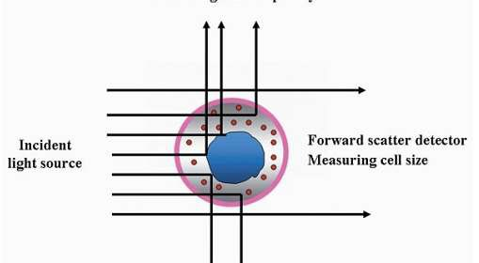
OPTICS - FORWARD SCATTER
(FSC)
Light that is scattered in the forward direction (along the same axis the laser is traveling) is detected in the Forward Scatter Channel.
The intensity of this signal has been attributed to
cell size, refractive index (membrane perm
eability).

Slide 13
OPTICS - SIDE SCATTER
(SSC)
Laser light that is scattered at 90 degrees to the axis of
the laser path is detected in the Side Scatter Channel.
The intensity of this signal is proportional to the amount
of cytosolic structure in the cell (eg. granules, cell
inclusion
s, etc.)
Side scatter detector
Measuring cell granularity

Slide 14



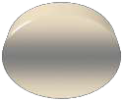
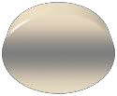
FSC
Detector
Laser Beam
Collection Lens
SSC
Detector

Slide 15

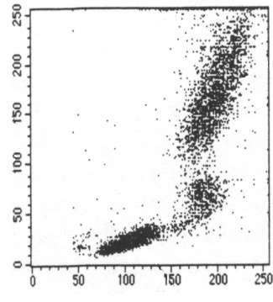
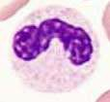

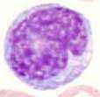

Why FSC & SSC?
Granulocytes
Lymphocytes
SSC
Monocytes
RBCs, Debris,
Dead Cells
FSC
Study of FSC and SSC allows us to know the differentiation of different types of cells.

Slide 16
The light scattered in the forward direction is proportional to the square of the radius of a sphere, and so to the size of the cell or particle.
The cells are labelled antibodies or stained with
with
fluorochrome-linked
fluorescent membrane,
cytoplasmic or nuclear dye.

Slide 17
Commonly used Fluorochromes
FLUOROCHROMES | EMISSION MAXIMUM
Fluorescein Isothiocynate (FITC) | 530nm
Phycoerythrin (PE) | 576nm
Peridin-chlorophyll alpha complex (PerCP) | 680nm
Allophycocyanin (APC) | 660nm
Texas red | 620nm
ECD( PE - Texas Red Tandem) | 615nm
PC5 (PE - cyanin 5 dye tandem) | 667nm

Slide 18
Optics
B) EMISSION OF FLUORESCENT LIGHT
(FLUORESCENCE)
As the fluorescent molecule present in or on the particle is interrogated by the laser light, it will absorb energy from the laser light and release the absorbed energy at longer wave length.
Emitted photons pass through the collection lens and are split and steered down specific channels with the use of filters.

Slide 19
Optics- Filters
Different wavelengths of light are scattered simultaneously from a cell
  Need to split the light into its specific wavelengths in order to measure and quantify them independently. This is done with filters.
The system of filters ensures that each photodetector receives light bands of various wavelengths.
Optical filters reflect some others.
Types of filters
  Long Pass
3. Band Pass
are designed such that they absorb or wavelengths of light, while transmitting
2. Short Pass
4. Dichroic

Slide 20

Optics- Long Pass Filters
Transmit all wavelengths greater than specified
wavelength
Example: 500LP will transmit all wavelengths greater
than 500nm
Transmittance
400nm
500nm
600nm
700nm
Original from Cytomation Training Manual

Slide 21
Optics- Short Pass Filter
Transmits all wavelengths less than specified
wavelength
  Example: 600SP will transmit all wavelengths less
than 600nm.
Transmittance
400nm
500nm
600nm
700nm
Original from Cytomation Training Manual

Slide 22
Optics- Band Pass Filter
Transmits a specific band of wavelengths
  Example: 550/20BP Filter will transmit wavelengths of light between 540nm and 560nm (550/20 = 550+/- 10, not 550+/-20)
Transmittance
400nm
500nm
600nm
700nm
Original from Cytomation Training Manual

Slide 23





Optics- Dichroic Filters
Long pass or short pass filters
Placed at a 45º angle of incidence
Part of the light is reflected at 90º , and part of the light is transmitted and continues.
Detector 1
Detector 2
Dichroic Filter

Slide 24
OPTICS - DETECTORS
The photodetectors convert the photons to electrical
impulses.
Two common types of detectors used in flow cytometry:
  Photodiode
used for strong signals, when saturation is a potential problem (eg, forward scatter detector).
  Photomultiplier tube (PMT)
more sensitive than photodiode but can be destroyed by exposure to too much light.
used for side scatter and fluorescent signols.

Slide 25
ELECTRONICS
The electronic subsystem converts photons to
photoelectrons.
Measures amplitude, area and width of photoelectron
pulse.
It amplifies pulse either linearly or logarithmically and then digitalizing the amplified pulse.

Slide 26















Electronics- Creation of a Voltage Pulse
Time

Slide 27
Data Analysis- Plot Types
There are several plot choices:
  Single Color Histogram
    Fluorescence intensity (FI) versus the number of cells counted.
  Two Color Dot Plot
    FI of parameter 1 versus FI of Parameter 2
  Two Color Contour Plot
    Concentric rings form around populations. The more dense the population, the closer the rings are to each other
  Two Color Density Plot
    Areas of higher density will have a different color than other areas

Slide 28
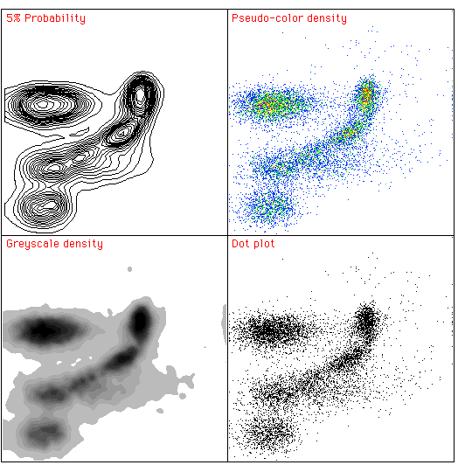
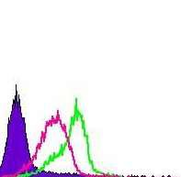
Plot Types
Contour Plot
Density Plot
Histogram
Greyscale Density
Dot Plot
www.treestar.com

Slide 29
DATA ANALYSIS - GATING
Gating is in essence electronic window that sets upper and lower limits on the type and amount of material that passes through.
Selection of only a certain population of cells for analysis on a plot.
Allows the ability to look at parameters specific to only that subset.

Slide 30
Interpretation of Graphs
An important tool for evaluating data is the dot plot.
The instrument detects each cell as a point on an X-Y graph. This form of data presentation looks at two parameters of the sample at the same time.

Slide 31
Three common modes for dot plots
are:
Forward scatter (FSC) vs. side scatter (SSC)
To look at the distribution of cells based upon size & granularity
Single color vs. side scatter
To visualize the expression of the fluorescence of the cells
Two-color fluorescence plot.
To differentiate between those cells that express only one of the particular fluorescent markers, those that express neither, and those that express both.
used to discriminate dead cells from the live ones that are expressing the desired fluorescence.

Slide 32
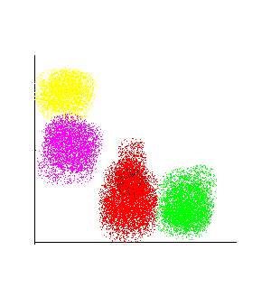


How to differentiate dim & bright
expression of an antigen?
Dim : cells are present more towards the origin(0) on x(red)
- y axis (pink)
BRIGHT
DIM
Y-axis CD4
Bright : cells are present away from the origin(0) on x(green) & y(yellow) axis.
X-axis CD8

Slide 33
WHAT IS UNIQUE IN
FLOWCYTOMETRY
MULTIPARAMETRIC
RAPID ANALYSIS OF LARGE NUMBER OF CELLS
INFORMATION AT A SINGLE CELL LEVEL
DETECTION OF RARE CELL POPULATIONS
ALLOWS PHYSICAL ISOLATION OF CELLS OF INTEREST

Slide 34

USES OF
FLOWCYTOMETRY

Slide 35
APPLICATIONS
ANALYSIS
  Immunophenotyping
  Dyes that bind to nucleic acids (DNA, RNA)
  Functional assays
CELL COUNTING
CELL SORTING

Slide 36
CLINICAL APPLICATIONS
HIV/AIDS
Absolute CD4 counts
Joint Pain
HLA B27 assay
Hematological
Malignancies
Diagnosis and Classification
Detection of MRD
Solid Tumours
DNA Ploidy
S Phase fraction
Primary
TBNK
Phagocytic function defect
Immunodeficiency disorders

Slide 37






Cont..
Hemolytic anaemia
Reticulocyte count
PNH
Osmotic fragility assay
Fetal Hb detection
Feto- maternal Hemorrhage
treatment response in Sickle Cell Anemia
Bleeding Disorders
Platelet receptor assays (Platelet count, GT, BSS)
Platelet function assay (CD62P, PAC-1)
CD34 STEM CELL COUNTS
Residual WBC count in leukodepleted blood packs
Flow cytometry Crossmatch
  Surface markers in PMN, Monocytes
  Cytokine response
Transfusion and
Transplant
Host Immune response in Sepsis

Slide 38
References
THE FLOW CYTOMETRIC EVALUATION OF HEMATOPOIETIC NEOPLASIA Brent L. Wood, Michael J. Borowitz. Henry’s, 22nd edition, Chapter 34
https://www.bosterbio.com/protocol-and-troubleshooting/flow-cytometry-principle
https://www.abcam.com/protocols/introduction-to-flow-cytometry
Video Link:
https://www.youtube.com/watch?v=5IdYFgYb9ls
https://www.youtube.com/watch?v=7bCZx5xPwt0&t=94s

