Slide 1
EARTHQUAKES
An earthquake is a major demonstration of the power of the tectonic forces caused by endogenetic thermal conditions of interior of the earth.
An earthquake is a motion of the ground surface.
According to A.N. Strahler and A.H. Strahler,(1976), ‘An earthquake is a vibration or oscillation of the surface of the earth caused by a transient disturbance of the elastic or gravitational equilibrium of the rocks at or beneath the earth the surface’.
The magnitude or intensity of energy released by an earthquake is measured by the Richter Scale devised by Charles F. Richter in 1935.
The number indicating magnitude or intensity (M) on Richter scale ranges between 0 and 9 but in fact the scale has no upper limit of number because it is a logarithmic scale.

Slide 2
Continued
The place of the origin of an earthquake is called focus which is always hidden inside the earth but its depth varies from place to place.
The deepest earthquake may have its focus at a depth of even 700 km below the ground but some of the earthquake have their focus around 20-30 km deep.
The place on the ground surface, which is perpendicular to the buried ‘focus’ or ‘hypocenter’ recording the seismic waves for first time is called epicenter.
The waves generated by an earthquake are called ‘seismic waves’ which are recorded by an instrument called seismograph or seismometer at the epicenter.
The science, that deals with the seismic waves is called seismology.

Slide 3
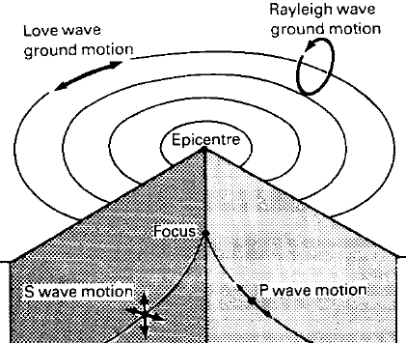
MACHENISM OF EARTHQUAKE

Slide 4
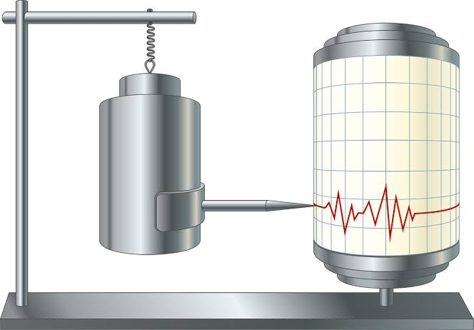
SEISMOMETER

Slide 5
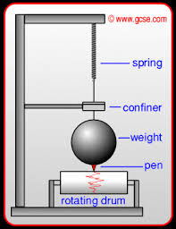
SEISMOMETER

Slide 6
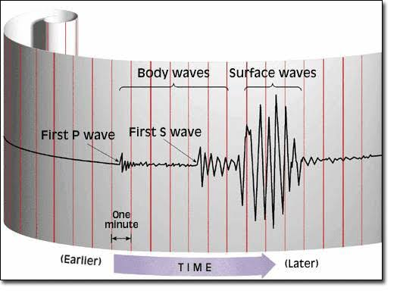
SEISMOGRAPH

Slide 7
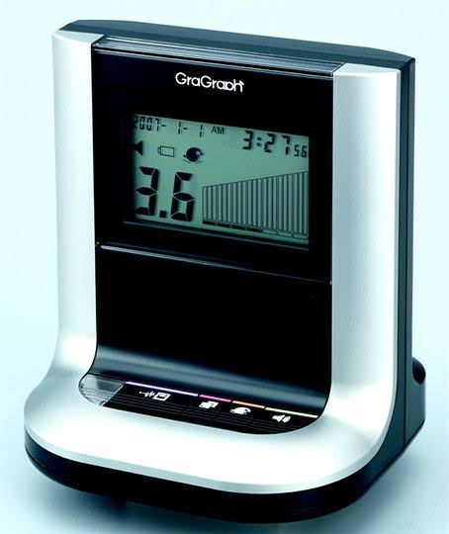
RICHTER SCALE

Slide 8
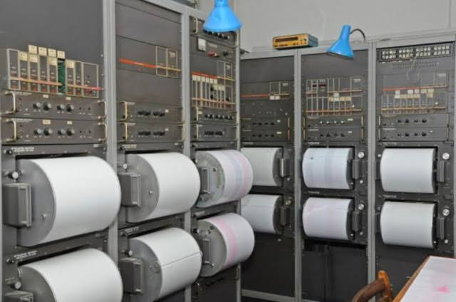
RICHTER SCALE

Slide 9
Causes of Earthquakes
Earthquakes are caused mainly due to disequilibrium in any part of the crust of the earth.
A number of causes have been assigned to cause disequilibrium or isostatic imbalance in the earth crust such as:---
Volcanic eruptions
Faulting and folding
Gaseous expansion and contraction inside the earth
Hydrostatic pressure of man-made water bodies like reservoirs and lakes
Plate movements
If we look at the world distribution of earthquakes it appears that the earthquakes are closely associated with the weaker zones and isostatically disturbed area of the globe.

Slide 10
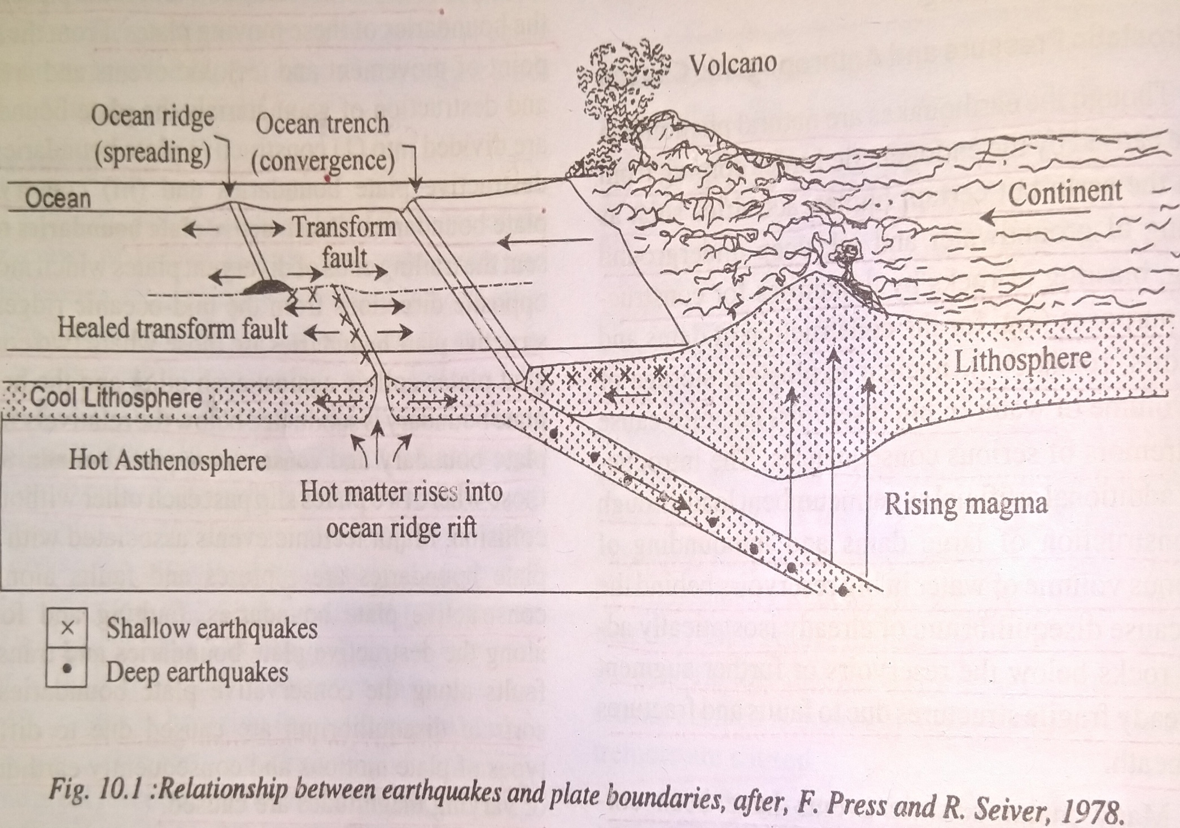

Slide 11
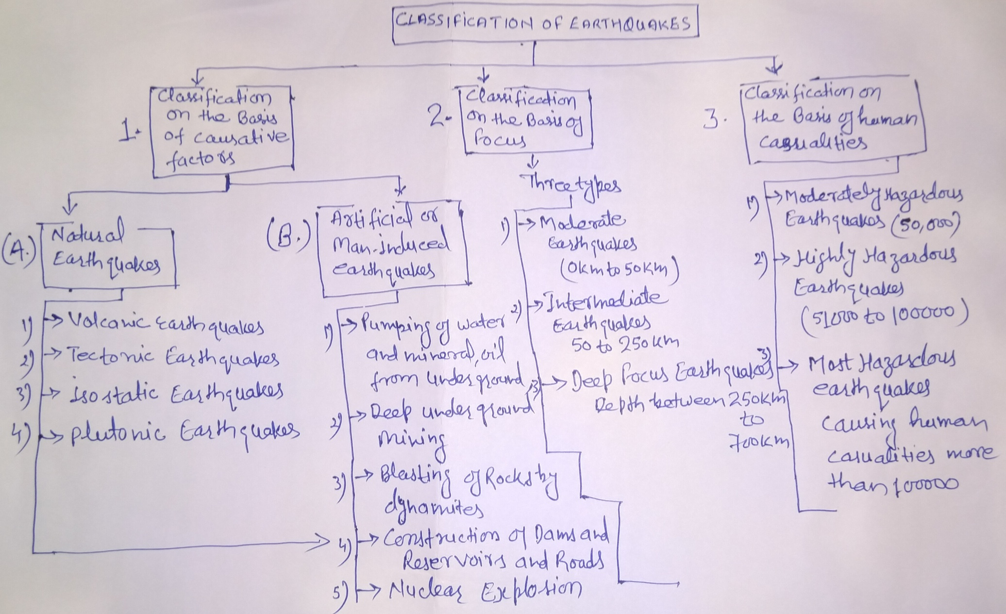
Classification of Earthquakes

Slide 12
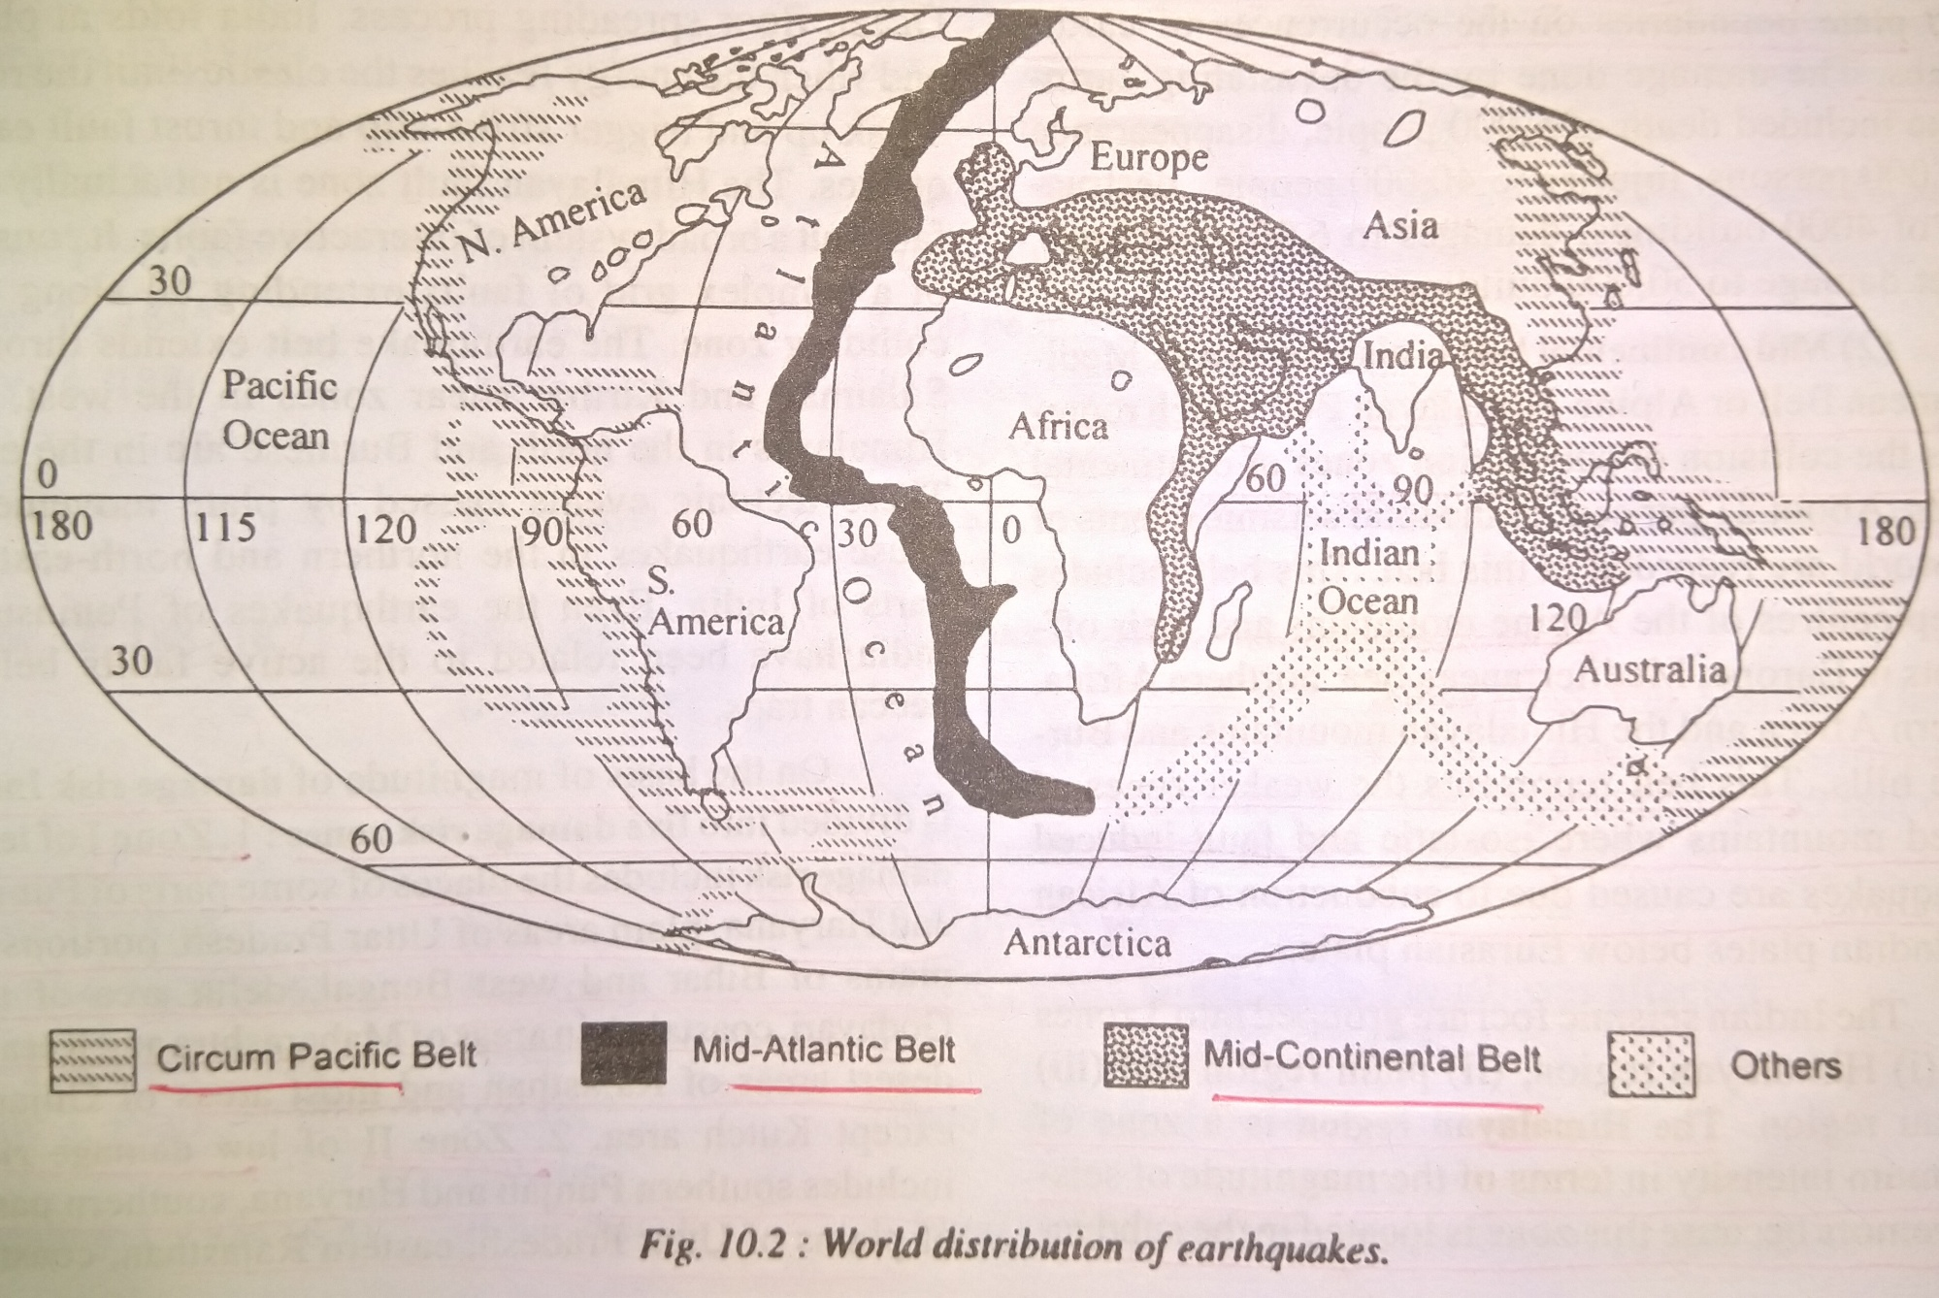
World Distribution of Earthquakes

Slide 13
Description
If we look at the world distribution map of earthquakes it appears that the seismic centre's are closely related to certain zones of the globe.
Earthquakes are, in fact, associated with the weaker and isostatically disturbed areas of the globe.
Most of the world earthquakes occur in
(1) the zone of young folded mountains,(2) the zone of faulting and fracturing (3) the zone representing the junction of continental and oceanic margins (4) the zone of active volcanoes, and (5) the zone of along different plate boundaries.

Slide 14
Traditional zone of world earthquakes
1).Circum- Pacific Belt
2). Mid-continental belt
3). Mid- Atlantic ridge belt

