Slide 1
Deforestation ‘Cutting down trees over a large area’
Deforestation is the clearing of trees, transforming a wooded area into cleared land. The first step in turning the wilderness into a shopping center is deforestation.
Or
Deforestation is when forests are destroyed by cutting trees (logging) and not replanting them. Some times deforestation happens when people change lands into farms, ranches and cities. The most common cause for deforestation is obtaining wood and fuel.

Slide 2
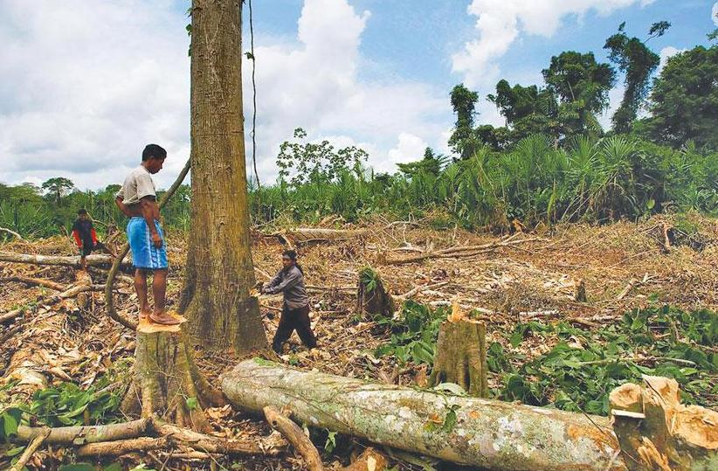
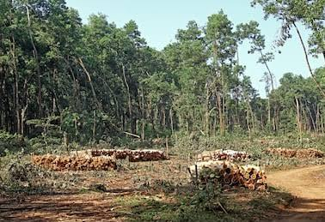
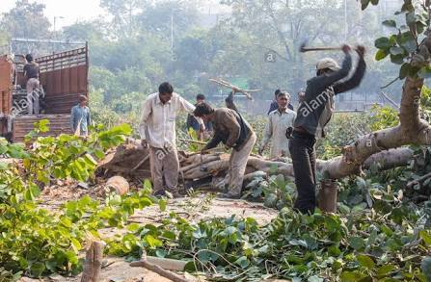
Images of deforestation in India

Slide 3
Image of deforestation

Slide 4
Causes of deforestation
Causes
Direct
Expansion of farming land
Forest and other plantations
Indirect
EXPLOITATION BY INDUSTRIALIZED COUNTRIES
Logging and fuel wood
Overgrazing
Fires
Mining
Urbanization/industrialization/ infra-structure
Air pollution
War and role of military
Tourism
Over population and poverty
Undervaluing the forest
Corruption and political cause

Slide 5
World deforestation
Mostly deforestation has occurred in the temperate and sub-tropical areas.
Direct causes
Expansion of farming land:-
About 60 percent of the clearing of tropical moist forests is for agriculture settlement with logging and other reason like roads, urbanization and fuel wood.
Millions of the people live on the tropical forest with less than a dollar a day where one third of a billion are estimated to be foreign settlers.
However, as the land degrades people are forced to migrate, exploring new forest frontiers increasing deforestation.
This is because agriculture land expansion is generally viewed as the main source of deforestation contributing around 60 percent of total tropical deforestation.
Shifting agriculture also called slash and burn agriculture is the clearing of forested land for raising or growing the crops until the soil is exhausted of nutrients and then moved on to clear more forest. It is been often reported as the main agent of deforestation.

Slide 6
Forest and other plantations
Plantations are a positive benefit and should assist in reducing the rate of forestation.
But the fact that plantation remove the timber pressure on natural forests does not translate eventually into less, but rather into more deforestation.
Indeed, it is feared that agricultural expansion which is the main cause of deforestation in the tropic might replace forestry in the remaining natural forests.
Tree crops and rubber in particular play a more important role in the deforestation in Indonesia than subsistence-oriented shifting cultivation

Slide 7
Logging and fuel wood
Logging does not necessarily cause deforestation. However, logging can seriously degrade forest. Logging in southeast Asia is more intensive and can be quite destructive.
Logging help in provide assess roads, clearing trees and preparing land for planting of crops or pasture. Logging thus catalyzes deforestation.
Fuel wood gathering is often concentrated in tropical dry forest and degraded forest areas.
Fuel wood is not usually the major cause of deforestation in the humid tropics although it can be in some populated regions with reduced forest area such as in Philippines, Thailand and part of central America.
Fuel wood gathering was considered to be the main cause of deforestation and forest degradation in El Salvador.

Slide 8
OVERGRAZING
Over grazing is more common in drier areas of the tropic where pastures degraded by overgrazing are subject to soil erosion. It is probably not a major cause of deforestation.
Clear cutting and overgrazing have turned large areas of Qinghai province in China into a desert.
The main impact of overgrazing to convert forest or vegetative cover into pastures or desert land.

Slide 9
Mining
Mining is very intensive and very destructive. The area of land involved is quite small and it is not seen as a major cause of primary deforestation.
Mining is a lucrative activity promoting development booms which may attract population growth with consequent deforestation.
India has caused large scale deforestation and created a huge water scarcity. Mining can cause serious deforestation in the region. On the other hand mining can be labour intensive and take labour away from clearing forest.

