Slide 5
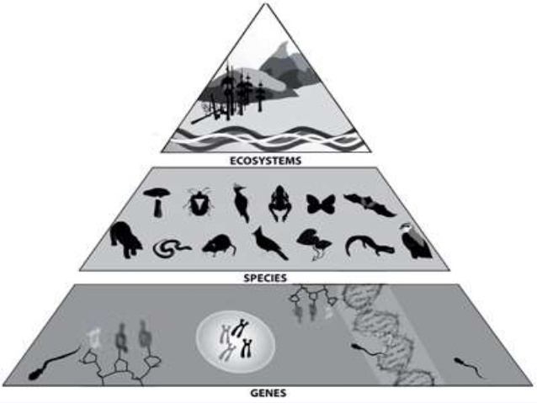

Slide 29
BIOGEOGRAPHICAL CLASSIFICATION OF INDIA
Ecologically and biogeographically, in the Indian subcontinent have a rainless desert and the rainiest place on earth, the hottest place on earth and the permanently snowbound heights of Himalayas.
Unique biogeographic position of the Indian subcontinents adds further interest to its wildlife.
The presence or absence of an animal or plant in a certain region is determined by ecological and historical factors.

Slide 30
Biogeographical zone of India

Slide 31
MAP

Slide 45
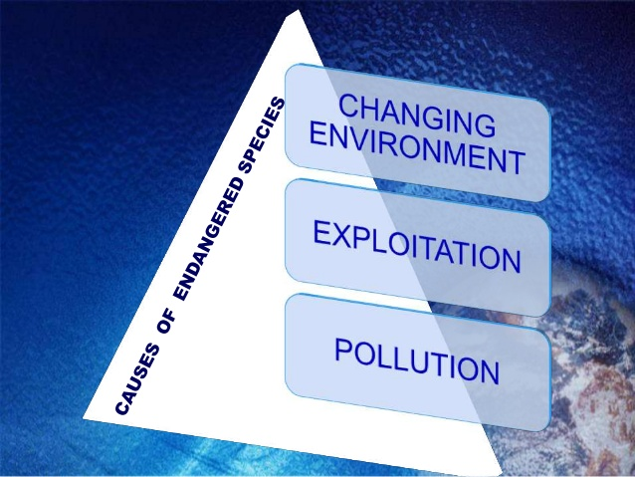

Slide 50
